Slide 1

Image Identification for Self-Driving Cars

Slide 3
SAFETY

Slide 4
SIMPLE

Slide 5
Outline

Slide 6
Outline
07
09
11
16
27
31
32
32
32
Motivation
Flowchart
Gui - TKinter
Object detection
Traffic Light Classification
Traffic Sign Classification
Program Architecture
Demo
Future Works and Optimization

Slide 7
Motivation

Slide 8
1. Among the flourishing development of self-driving car technology, 2D images recognition for identifying objects such as cars, pedestrians, traffic lights, etc., is one of the techniques that attract extensive attention.
2. In recent years, self-driving car research on the market has not yet reached the fully mature stage.
3. The foreign scenes are quite different from the Taiwan scenes, especially motorcycles and traffic signs.

Slide 9
Flowchart

Slide 10

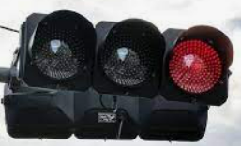
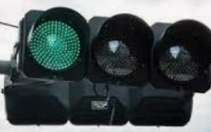


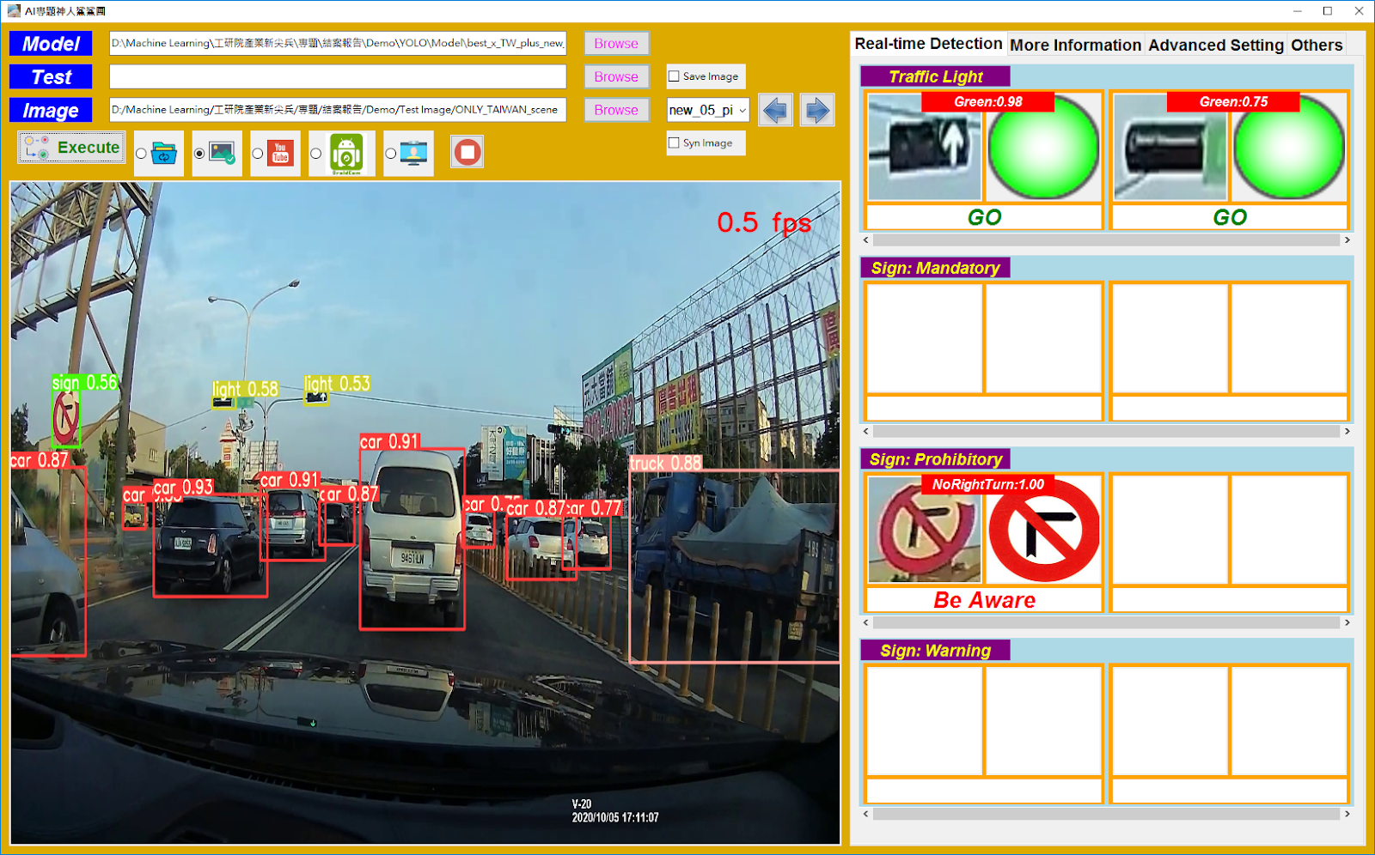
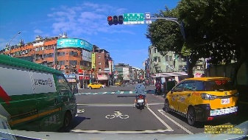
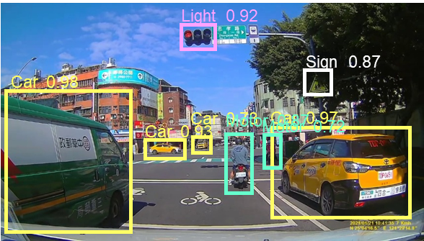


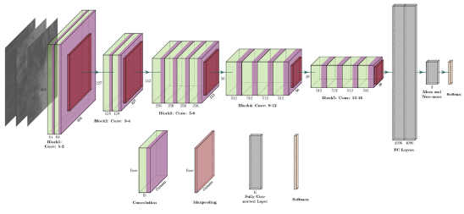









Flowchart
ML model - SVM
Traffic light classification
Flowchart
Yolov5
GUI
DashCam record
Road narrows
No right turn
Roundabout
…
Pedestrians
Speed limit
Keep left
Classification of 45 Traffic signs

Slide 11
GUI TKinter

Slide 13
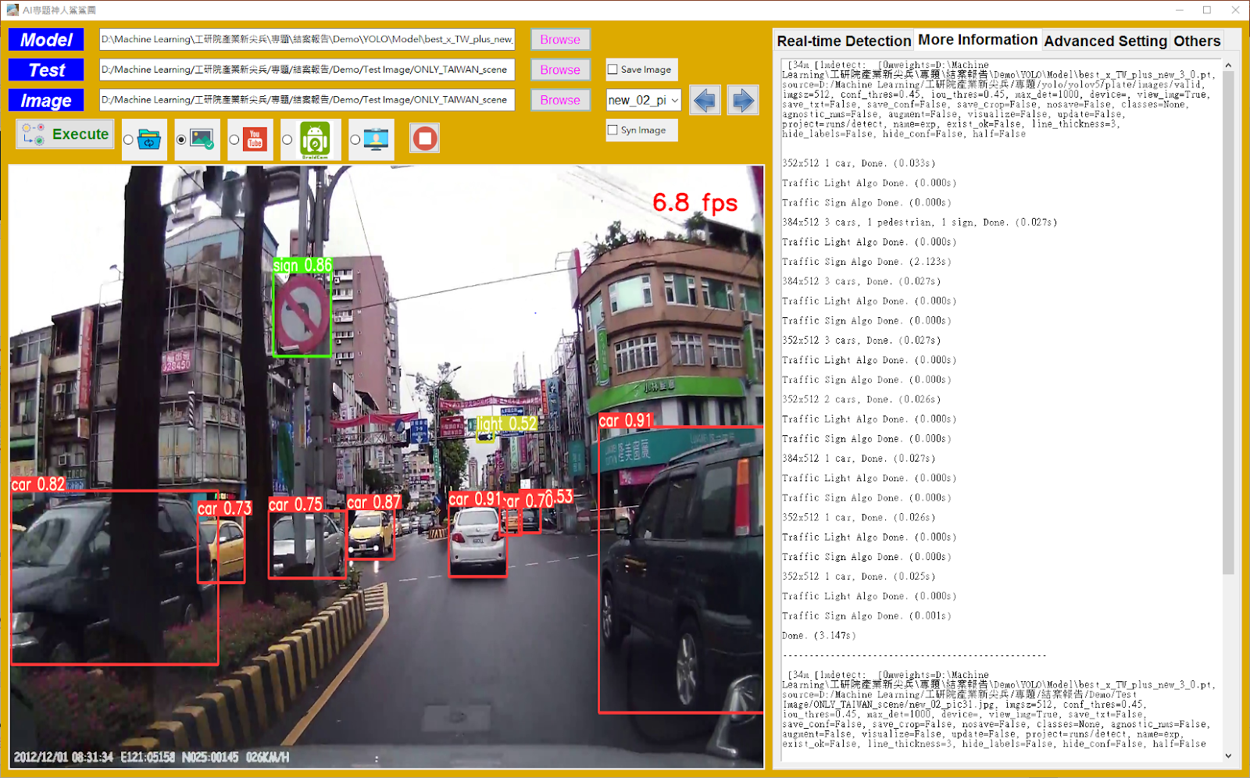

Slide 14
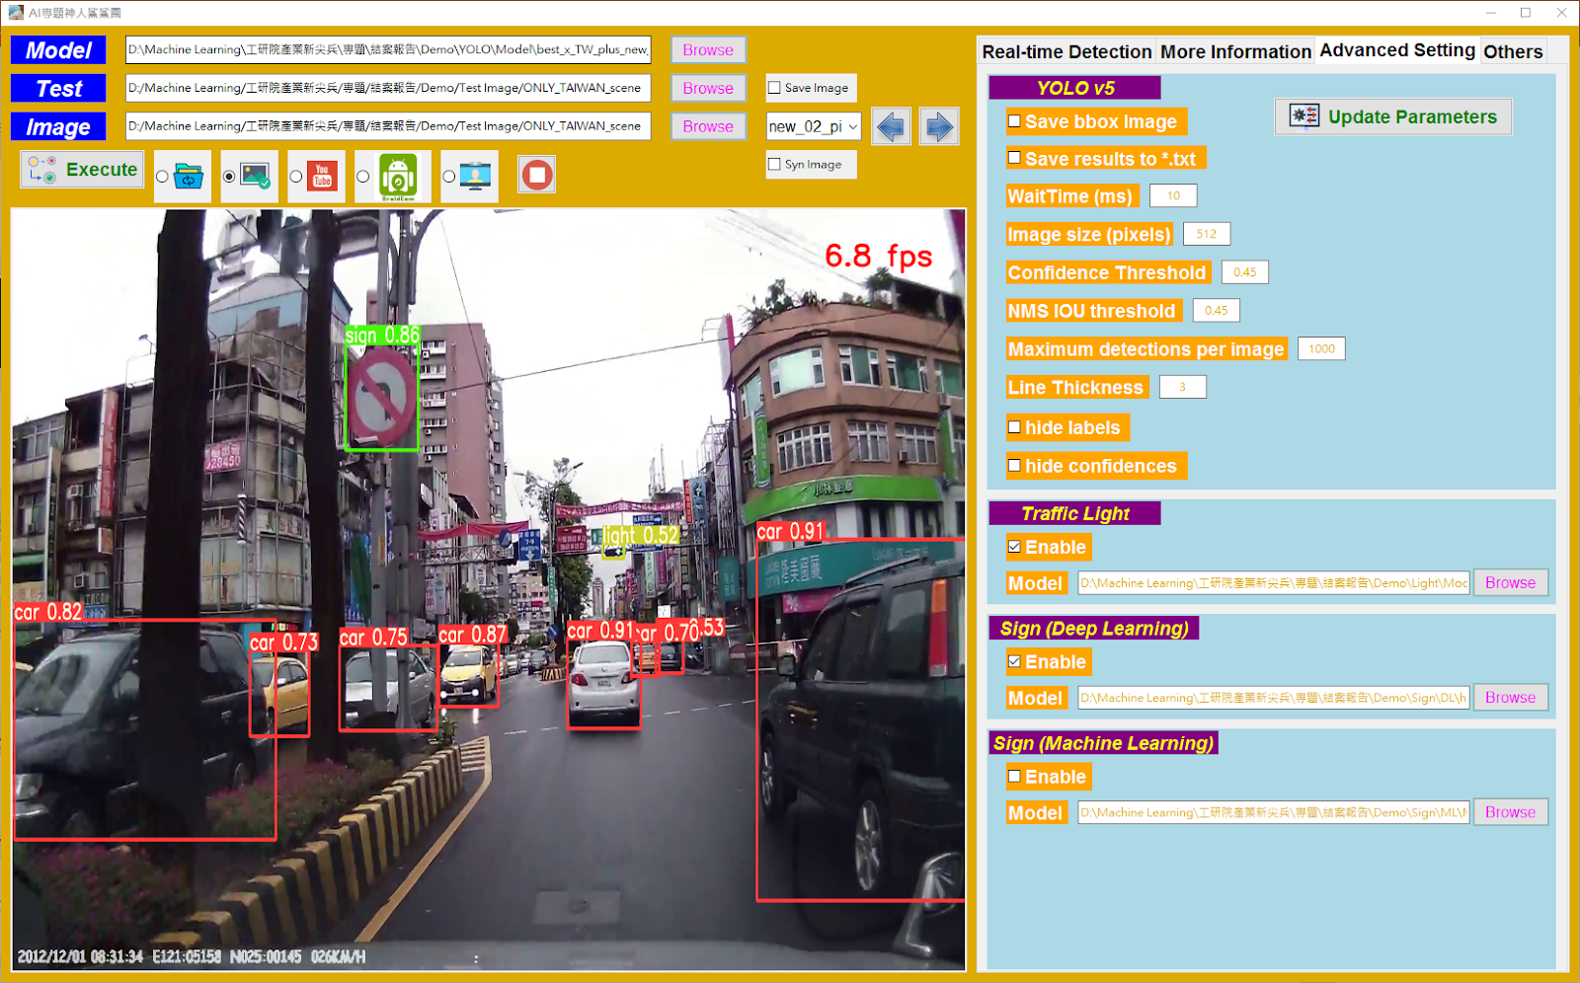

Slide 15
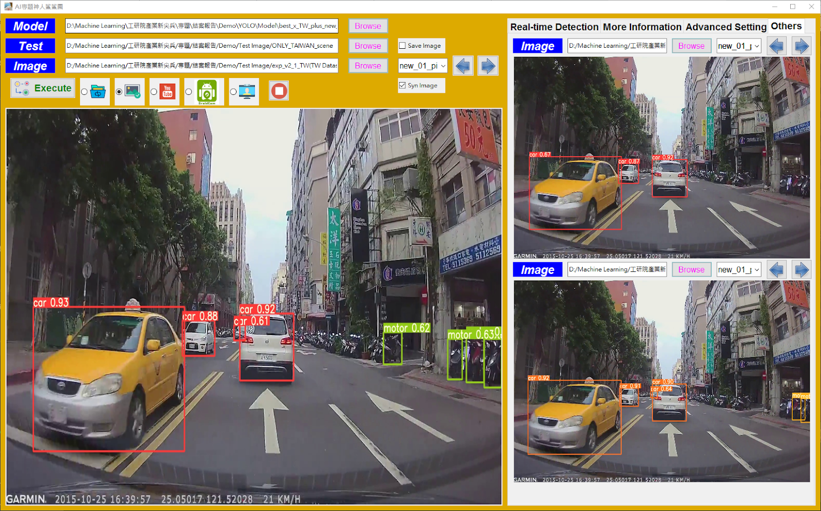

Slide 16
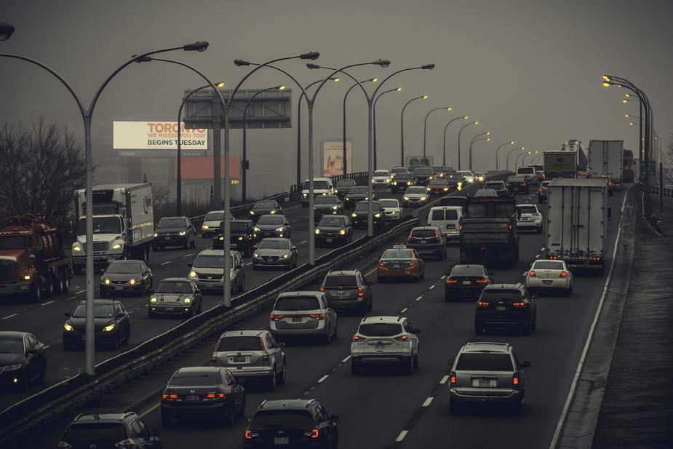
TRUCK
Object detection

Slide 17
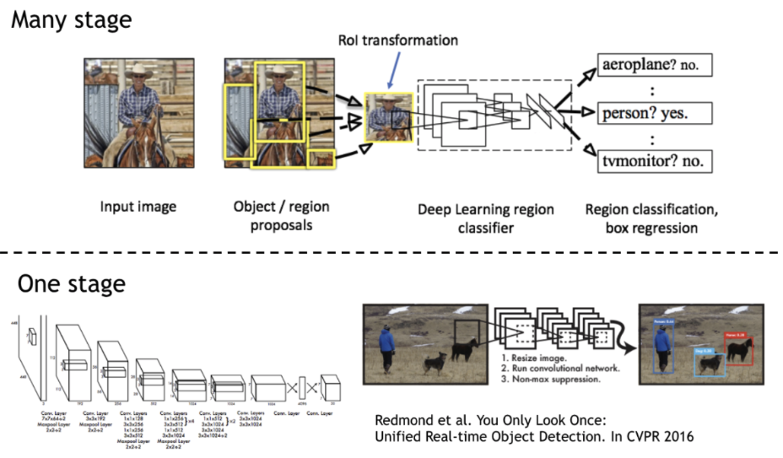
One stage v.s. Two Stages
Training separately
Training time ↓
YOLO v1~v5
End-to-end

Slide 18
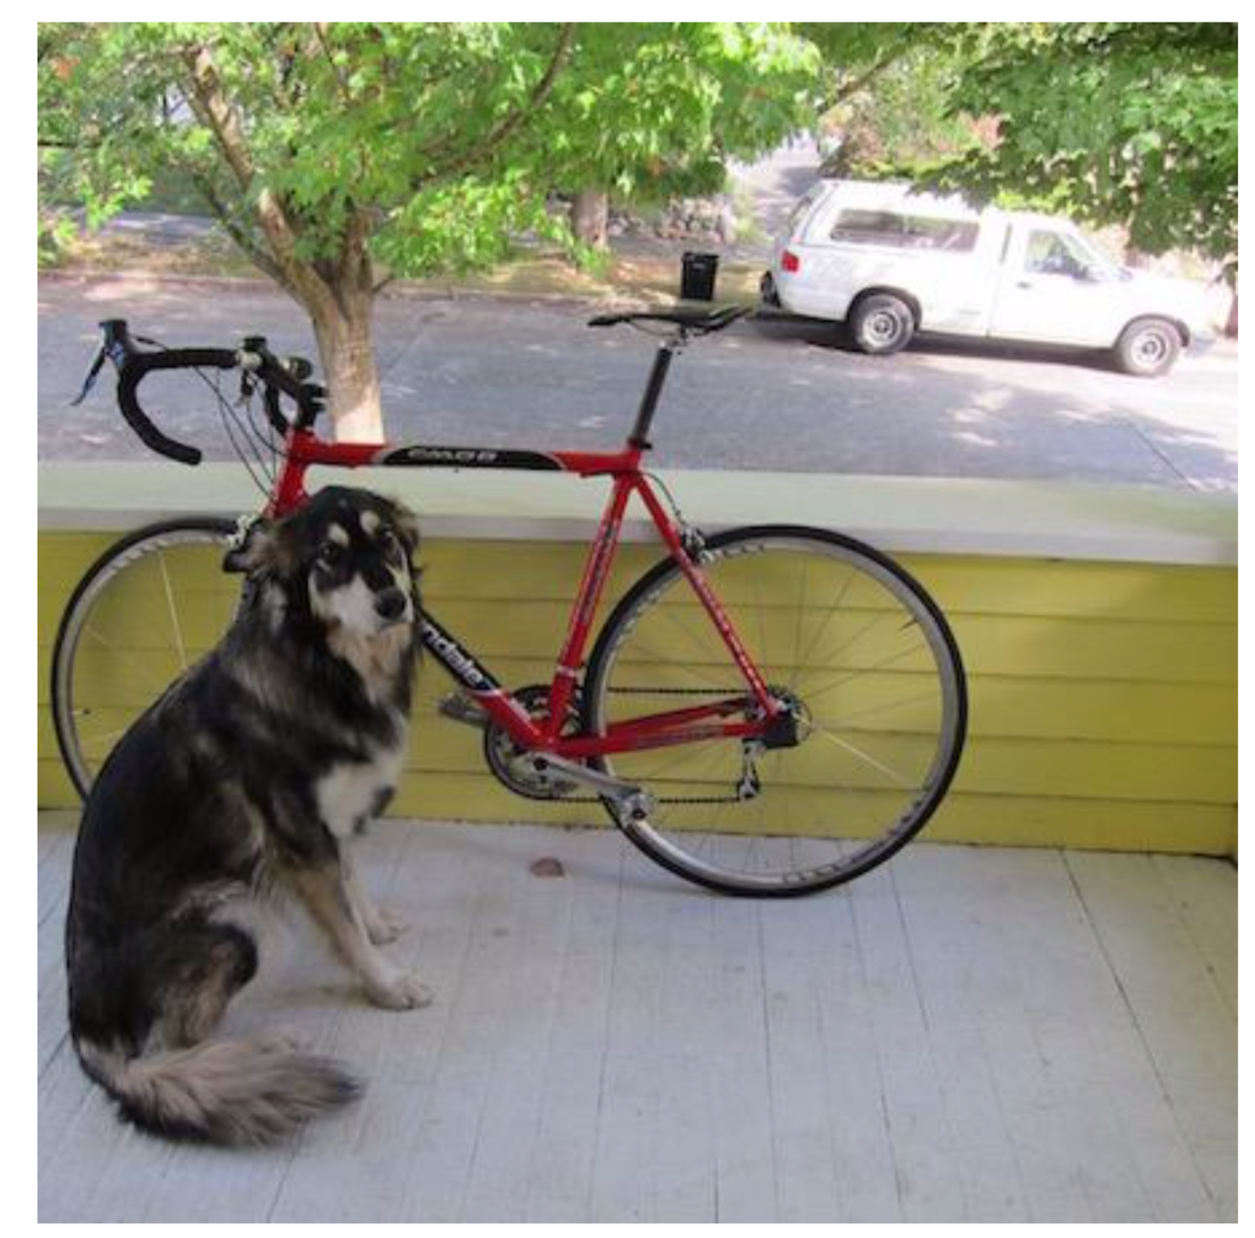
YOLO v1: You Only Look Once

Slide 19
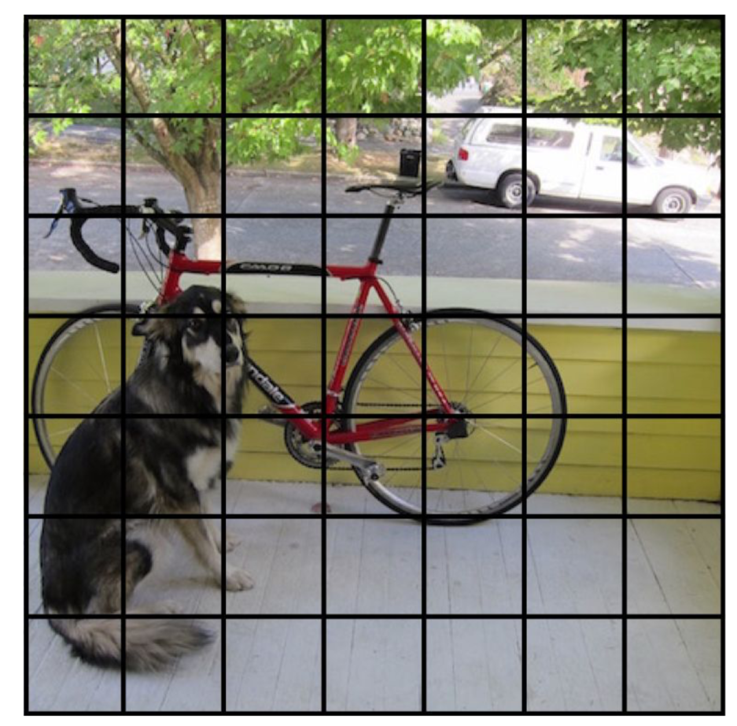
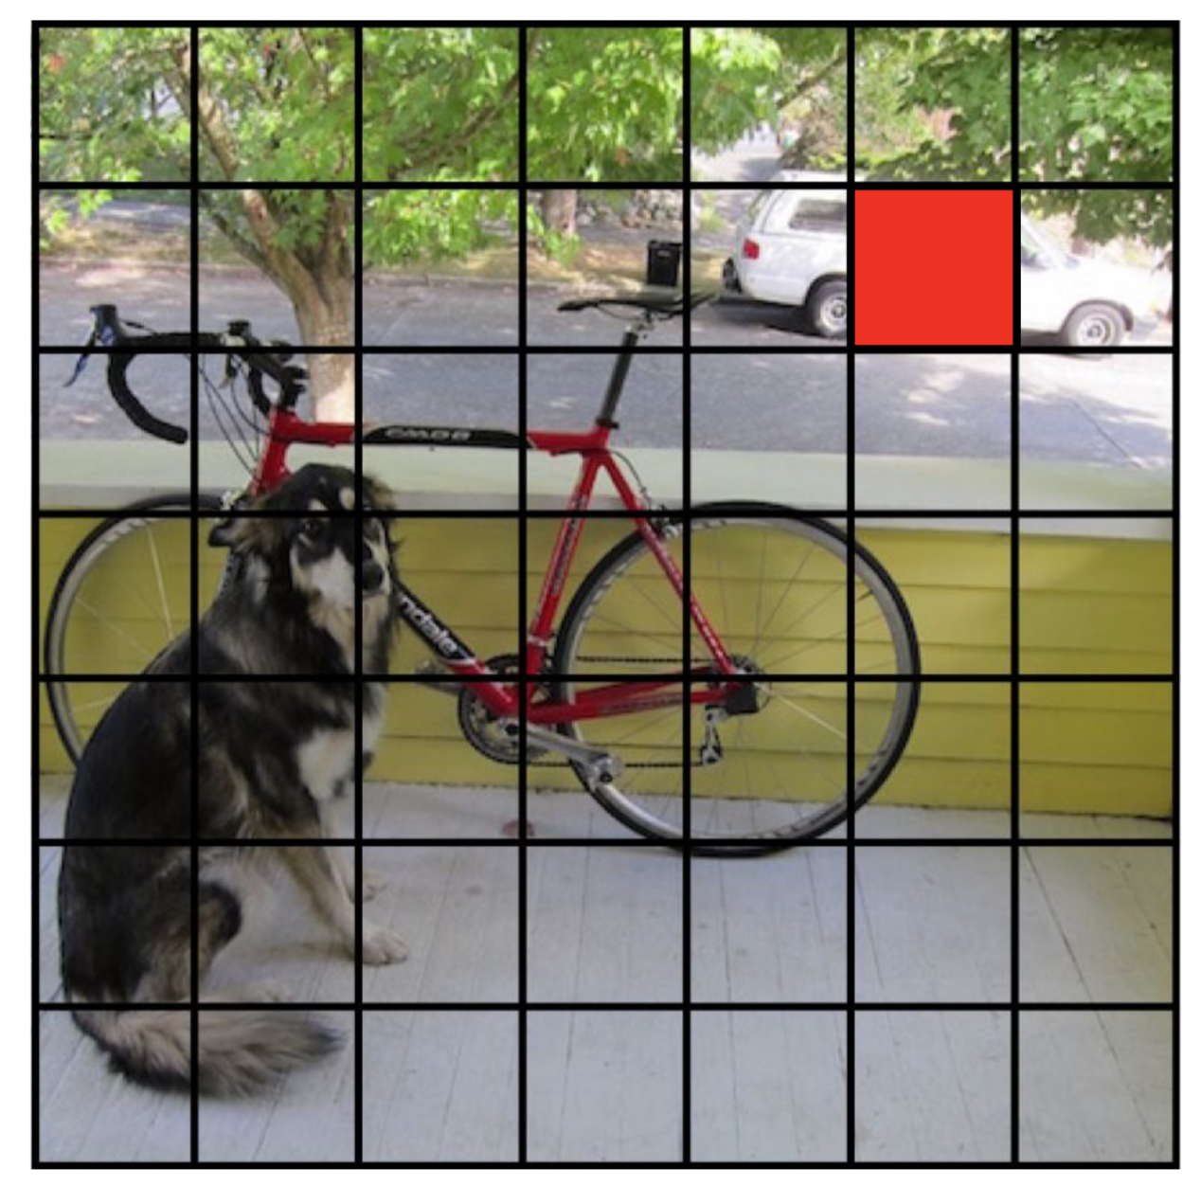
YOLO v1: You Only Look Once

